Slide 1
Machine Learning: Making computers Learn
-Aravind Daram

Slide 2
Agenda
Statistical ML – Definition
Basic concepts of Statistical ML and terminologies
Types of Statistical ML
Common Statistical ML Models
Linear Regression
Logistic Regression
Decision Tree
Random Forest
K-Means clustering
Principal Component analysis

Slide 3
Statistical ML - Definition
Statistical machine learning is a field that combines statistical techniques with machine learning and artificial intelligence (AI) technologies to create models that can learn from data and make predictions.

Slide 4
Basic Statistics Concepts
Types of Data
Measures of Central Tendency
Measures of Spread
Explore numerical, categorical, and ordinal data, understanding their characteristics and appropriate analysis techniques.
Understand standard deviation, variance, and range as measures of how data points are dispersed around the central tendency.
Learn about mean, median, and mode, and how to use them to describe the center of a dataset.

Slide 5
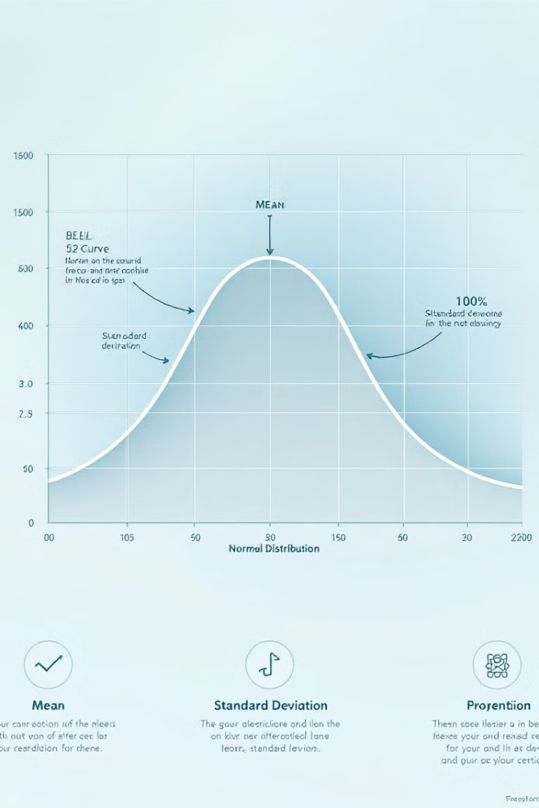
Normal Distribution and Empirical Rule
1
The Foundation of Statistical Inference
2
Empirical Rule
The empirical rule helps you estimate the percentage of data that falls within certain standard deviations from the mean.
The normal distribution plays a crucial role in statistical inference and hypothesis testing.
3
Real-World Applications
Understand how the normal distribution models various phenomena, from heights and weights to exam scores.

Slide 6
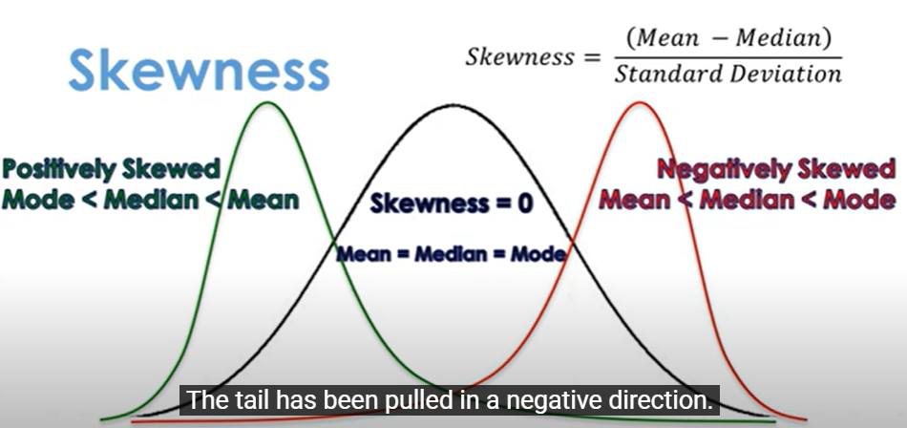
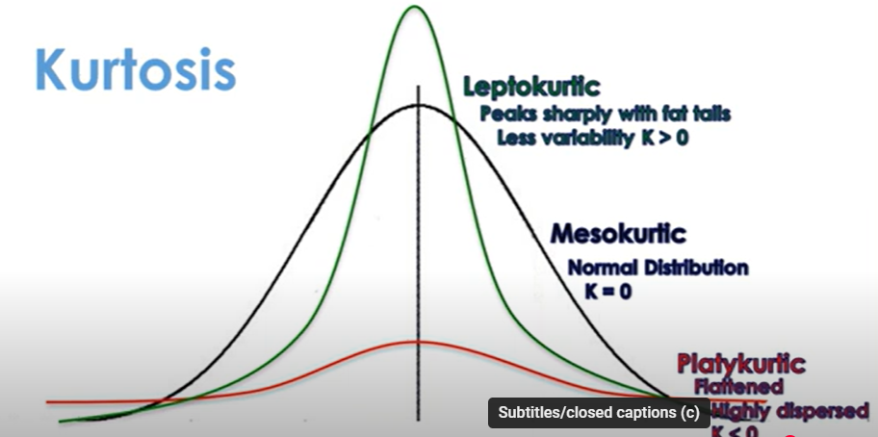
Skewness and Kurtosis
Skewness
Kurtosis
Analyze how data distributions are asymmetric, describing their tail behavior.
Understand how data distributions differ in their peak and tail behavior, characterizing their "tailedness."

Slide 7
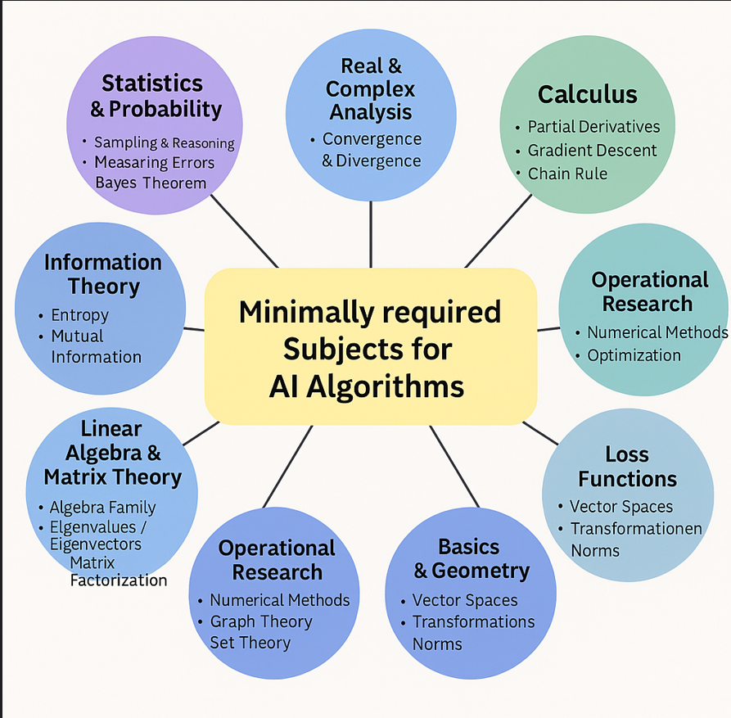
Mathematics in AI – more detailed

Slide 8
Mathematics in AI – more detailed –Tabular form
Subject Area | Key Topics / Concepts | Example Algorithms / Models
Statistics & Probability | Sampling & Reasoning, Measuring Errors, Bayes Theorem | Naive Bayes, Gaussian Mixture Models, Hidden Markov Models
Real & Complex Analysis | Convergence & Divergence | Gradient Descent, Backpropagation in Deep Learning
Calculus | Partial Derivatives, Gradient Descent, Chain Rule | Neural Networks (training phase), Support Vector Machines
Information Theory | Entropy, Mutual Information | Decision Trees, ID3/C4.5, Autoencoders
Linear Algebra & Matrix Theory | Eigenvalues, Eigenvectors, Matrix Factorization | PCA, Word2Vec, Transformer Models
Operational Research (I) | Numerical Methods, Optimization | Linear Regression, Logistic Regression, Q-Learning
Operational Research (II) | Graph Theory, Set Theory | Graph Neural Networks, Knowledge Graphs
Basics & Geometry | Vector Spaces, Transformations, Norms | k-NN, SVM (with kernel tricks), Cosine Similarity
Loss Functions | Vector Spaces, Transformations, Norms (applied to loss functions) | MSE, Cross-Entropy Loss, Hinge Loss in SVM

Slide 9
Machine Learning Types
Supervised Learning:
Regression (continuous output)
Classification (discrete output)
Unsupervised Learning:
Clustering
Dimensionality reduction
Association Rule learning
Re-enforcement learning
Semi-supervised Learning:
Combines labeled and unlabeled data

Slide 10
Machine Learning Types
Regression (continuous output)
Linear Regression
Polynomial regression
Logistic Regression
Ridge Regression
Decision Tree Regression
Classification (discrete output)
Binary Classification
Multi-class classification
Multi-Label Classification

Slide 11
Common Statistical ML Models
Clustering Algorithms
Dimensionality reduction
Classification Algorithms
Regression Algorithms
Principal Component Analysis (PCA)
t-SNE
Logistic Regression
Decision Tree
Random Forest
Support Vector machines
K-Nearest Neighbors
Neural Networks
Decision Tree
Random Forest
Linear Regression
Ridge Regression
Lasso Regression
Polynomial Regression
Decision Tree
Random Forest
K-Means
Hierarchical Clustering
DBSCAN

Slide 12
Linear Regression
Definition
Visualization
Performance metrics
It used to for Regression tasks. It predicts a continuous outcome(target variable/dependent variable) based on one or more predictors(independent variables).
Fits a linear relationship between the independent (predictors) variables and the output (dependent/target) variable.
Mean Absolute Error (MAE)
Mean Squared Error (MSE)
Root Mean Squared Error (RMSE)
R-squared (R²)
Adjusted R-squared.

Slide 13
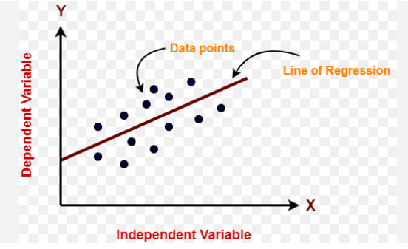
Linear Regression – training methodology
Visualization
Linear regression model learns the best-fit that minimizes the difference between predicted and actual target values, thus providing accurate predictions on new data.
It follows below steps
Linear equation
Calculate the cost (error) using the Mean Squared Error (MSE) function
Gradient Descent to reduce the error
It iterates over the dataset row by row, updating the coefficient each time, until it se the coefficients that minimize the error.

Slide 14
House Price Prediction
Size (SqFt) | BedRooms | Price ($1000)
1500 | 3 | 400
2000 | 4 | 500
2500 | 4 | 550
1200 | 2 | 280

Slide 15
House Price Prediction
Y: Predicted House Price
X 1​ : Size (SqFt)
X 2​ : BedRooms
w1​ ,w2​ : Weights (coefficients) learned by the model
b: Bias (Y intercept) – the price when the Size and bed rooms are Zero.
Linear Equation
Y=w1​⋅X1​+w2​⋅X2​+b
Step 1
Model assumes random values for w 1​ ,w 2​ , and b
Example:
Y=0.079⋅X1​+59.43⋅X2​+133.94
Step 2
Using step 1 equation, calculate the predicted values (Y^ ) for each row in the dataset.
1st Row Predicted Yield =
0.079 ⋅ 1500+59.43 ⋅ 3+133.94=400
2nd Row Predicted Yield =
0.079 ⋅2000+59.43⋅3+133.94=500
Step 3
For each data point, calculate the squared error.
𝐸𝑟𝑟𝑜𝑟=(𝑌−𝑌^)2
Sum up all the errors and compute the MSE
Gradient Descent adjusts w1,w2 and b iteratively to reduce the MSE

Slide 16
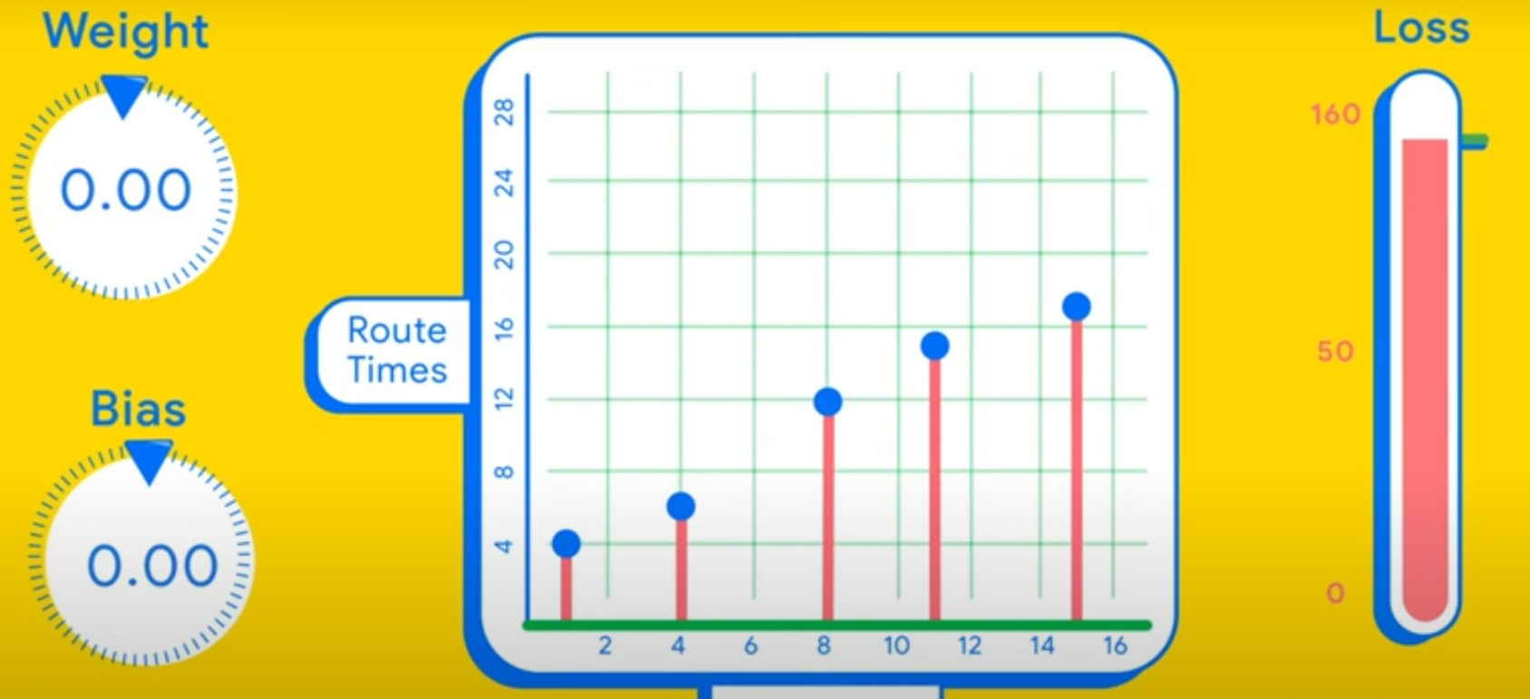
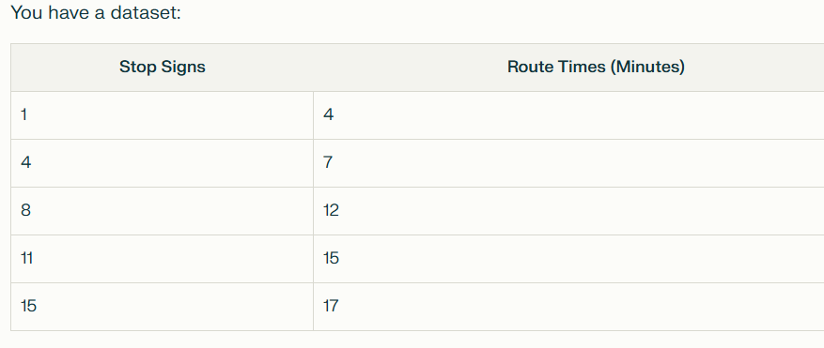
Gradient Descent explained more detailed
Data set
Loss – 144.6
Using step 1 equation, calculate the predicted values (Y^ ) for each row in the dataset.
1st Row Predicted Yield =
0.079 ⋅ 1500+59.43 ⋅ 3+133.94=400
2nd Row Predicted Yield =
0.079 ⋅2000+59.43⋅3+133.94=500
Calculation
(4 - 0)^2 = 16
(7 - 0)^2 = 49
(12 - 0)^2 = 144
(15 - 0)^2 = 225
(17 - 0)^2 = 289
Sum = 16 + 49 + 144 + 225 + 289 = 723
Mean = 723 / 5 = 144.6
The most common loss function for regression is Mean Squared Error (MSE):
Loss=1N∑i=1N(Actuali−Predictedi)2
Where:
N = number of data points (here, 5)
ActualiActuali = actual route time for data point i
PredictediPredictedi = predicted route time for data point i

Slide 17
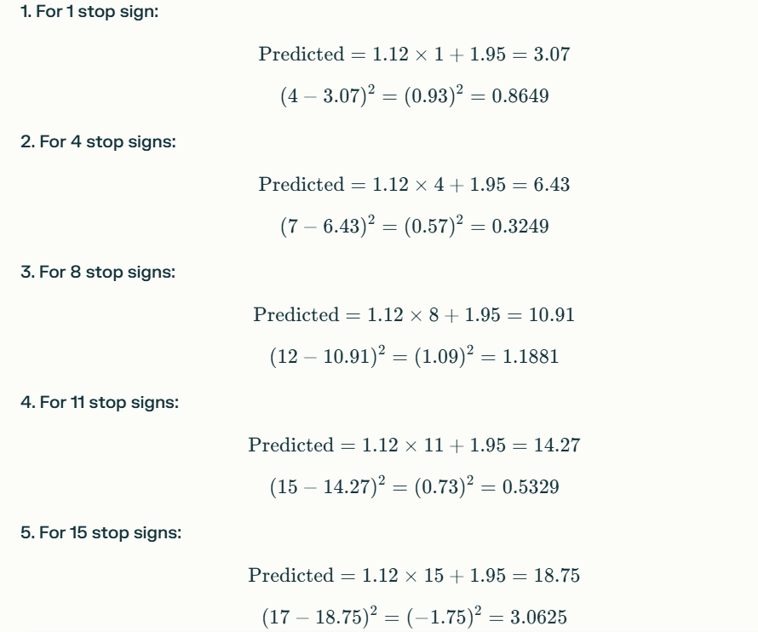
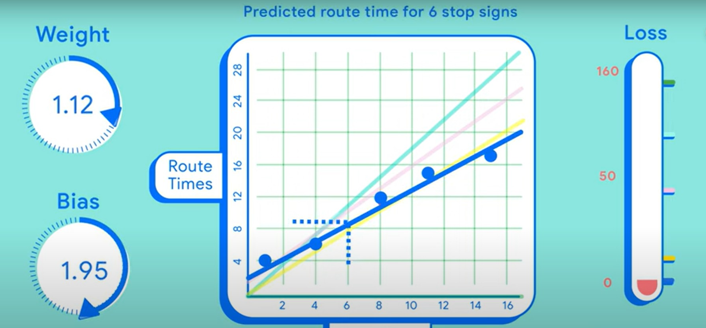
Gradient Descent explained more detailed
Loss – 1.1947
Calculation
Sum of Squared errors:
0.8649+0.3249+1.1881+0.5329+3.0625=5.9733
Mean Squared error (Loss) = 5.9733 /5 = 1.1947

Slide 18
Gradient Descent - Summary
Term | Meaning
Loss Function | Measures how well predictions match actual data
High Loss | Bad predictions (model needs improvement)
Low Loss | Good predictions (model fits the data well)
Goal | Adjust model parameters to minimize the loss

Slide 19
Linear Regression – Use cases
Use Case | Description
Predicting House Prices | Linear Regression is used to estimate house prices based on features like size, location, and age of the house. etc.
Estimating Sales Revenue | Predicting the sales revenue based on factors like advertising budget and sales efforts and help the business.
Forecasting Temperature | Predicting the temperatures based on weather conditions and time of day.
Student Performance | Predicting the final exam score based on factors like study hours, previous grades and attendance percentage.
Employee Salary Prediction | Predicting an employee's salary based on experience, education, and job sector.

Slide 20
Logistic Regression
Definition
Visualization
Performance metrics
It used for Classification tasks. It predicts the probability of an outcome (target/dependent) belonging to a particular category based on one or more predictors(independent variables).
Fits a non-linear (logistic) relationship between the independent (predictor) variables and the probability of the binary output (dependent/target) variable.
Accuracy
Precision
Recall (Sensitivity)
F1-Score

Slide 21
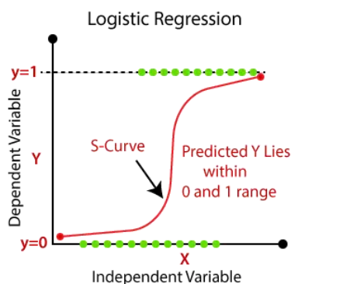
Logistic Regression – training methodology
Logistic regression model learns the best-fit that minimizes the difference between predicted and actual target values, thus providing accurate predictions on new data.
It follows below techniques
Applying a linear combination of the predictors
Transforming this linear combination using the logistic (sigmoid) function
Outputting probabilities between 0 and 1 for binary classification

Slide 22
Predicting Student – Pass or Fail
Hours Studied | Result (Y)
2 | 0
3 | 0
5 | 1
7 | 1
8 | 1

Slide 23
Student Exam - prediction
Linear Equation
Y=w1​⋅X1​+w2​⋅X2​+b
Y: Student Exam result
X 1​ : Hours of Study
w1​ ,w2​ : Weights (coefficients) learned by the model
b: Bias (intercept)
Step 1
Model assumes random values for w 1​ ,w 2​ , and b
Example:
Y=0.7⋅X1​+0.7⋅X2​+0
Step 2
Using step 1 equation, calculate the predicted value (Y^ ) and applies sigmoid for each row in the dataset.
1st Row Predicted Yield =
0.7 ⋅2+0=1.4
Sigmoid(1.4)=0.802
Step 3
For each data point, calculate the cost function(log loss).
LogLoss=−[𝑦⋅log⁡(𝑝)+(1−𝑦)⋅log⁡(1−𝑝)]
−[1⋅log⁡(0.802)+(1−1)⋅log⁡(1−0.802)] = 0.220
Sigmoid converts linear output to probability between 0 and 1.
Gradient Descent adjusts w1,w2 and b to minimize the loss.

Slide 24
Logistic Regression – Use cases
Use Case | Description
Email Spam Detection | Classifies emails as spam or not spam based on Word frequencies, Sender reputation and email length.
Loan Default Prediction | Predicts whether a loan will default based on customer data like credit score, income, loan amount and previous defaults.
Disease Diagnosis | Predicts the presence of a disease based on patient symptoms, age, family history and test results.
Churn Prediction | Predicting whether a customer will stop using a subscription-based service by checking usage pattern, tenure, complaint history and subscription type.
Social Media Ads | Predicts whether a user will click on an ad based on user behavior, age , time spent on the platform and demographics. Etc.

Slide 25
Bob's Cruise plan selection
Budget Plan (1000-2500$) | Premium plan (2500-5000$) | Luxury plan (5000$+)
3-5 days Cruises | 6-9 days cruises | 7-14 days cruises
Destinations – Mexico/Caribbean | Destinations- Mediterranean/Alaska | Worldwide destinations
Standard Cabins | Balcony Cabins | Suite accommodations
Basic dining | Special dining included | All-inclusive dining
Standard activities | Premium activities | Exclusive Experience
Bob wanted a vacation plan with his family, and he had good number of PTOs and prepared with good budget planning, which plan do you suggest.
Bob wanted a vacation plan with his family by he had limited budget, but he had good number of PTOs , which plan do you suggest ?
Bob desperately need a break from his work, but he don’t have enough PTOs , he can manage 3 days of PTOs, which plan do you suggest?
Bob is OK with any kind of accommodation, but his family wanted a long travel along great comfort while cruise travel , which plan do you suggest ?

Slide 26
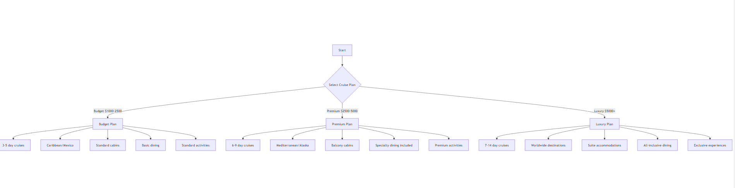
Decision Tree – Cruise plan

Slide 27
What is decision tree primarily used for in Machine learning?
To perform Clustering the data.
To model the relationship between variables using linear equation
To make Decisions or Predictions based on hierarchical structure nodes
To reduce the dimensionality of Data.

Slide 28
Decision Tree
Definition
Visualization
Performance metrics
It used for both Regression and Classification tasks. It predicts decisions by splitting data based on feature values.
Fits the data in the form of simple tree by splitting the data into subsets based on the feature values then make predictions.
Each node will have Gini/Entropy calculations. Or error measure (e.g. MSE) for each split.
Regression:
Mean Absolute Error (MAE)
Mean Squared Error (MSE)
Root Mean Squared Error (RMSE)
R-squared (R²)
Adjusted R-squared.
Classification:
Accuracy
Precision
Recall (Sensitivity)
F1-Score

Slide 29
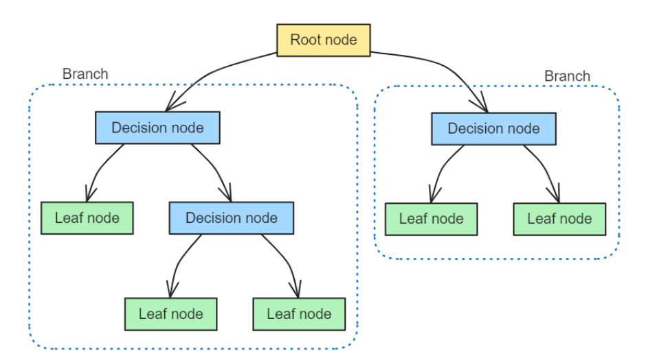
Decision Tree– representation

Slide 30
Decision Tree– Use cases
Use Case | Description | Model Type
Disease Diagnosis | Predicts the likelihood of a disease (e.g., diabetes, heart disease) based on patient data(Age, Glucose Level, Blood Pressure, Symptoms). | Classification
Loan Approval | Determines whether a loan should be approved or not based on applicant data(Income, Credit Score, Employment History). | Classification
Sales Forecasting | Predicts future sales for a product based on historical data(Time, Product Type, Region, Promotions). | Regression
Fraud Detection | Identifies fraudulent transactions based on historical transaction patterns(Amount, Location, Time of Day, Merchant Type). | Classification
Employee Attrition Prediction | Predicts whether an employee will leave a company based on workplace and personal factors(Salary, Work Hours, Job Satisfaction, Tenure). | Classification

Slide 31
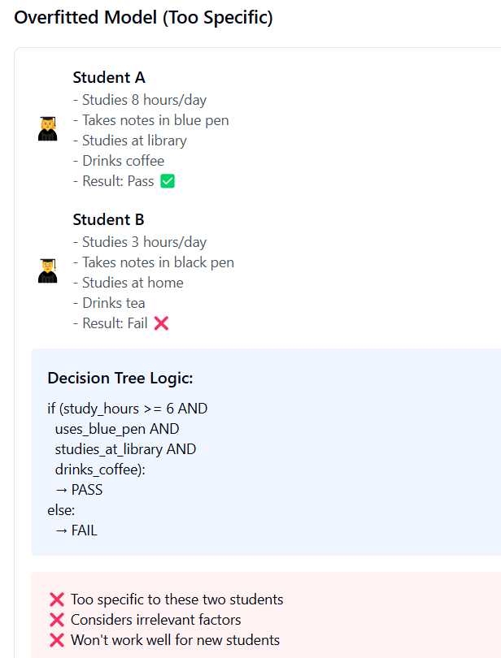
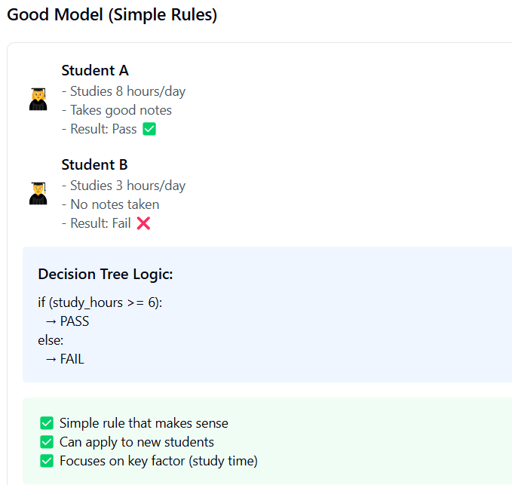
Decision Tree - overfitting
Notes:
Key Takeaways:
✅ Good Model: Focuses on what truly matters (study hours)
❌ Overfitted Model: Gets distracted by irrelevant details (pen color, drink choice)
💡 Real World Impact: Good model helps new students succeed, overfitted model gives misleading advice

Slide 32
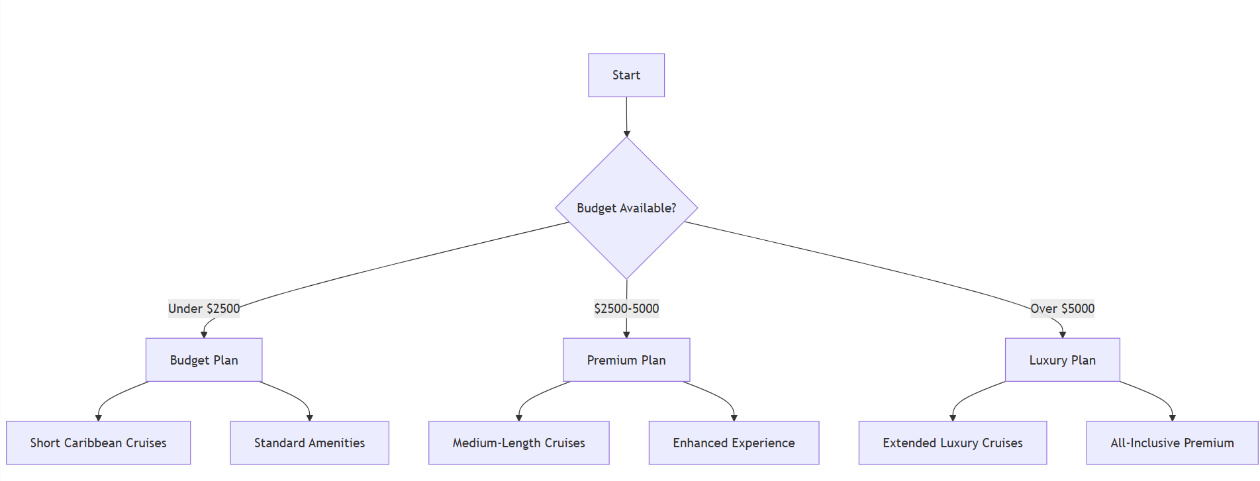
Decision Tree (Pruned)– Cruise plan

Slide 33
Which of the following are primary reasons for pruning Decision Trees(Select all that apply)?
To increase the depth of the tree
To reduce overfitting
To improve the tree's ability to generalize to new data
To make the tree more complex

Slide 34
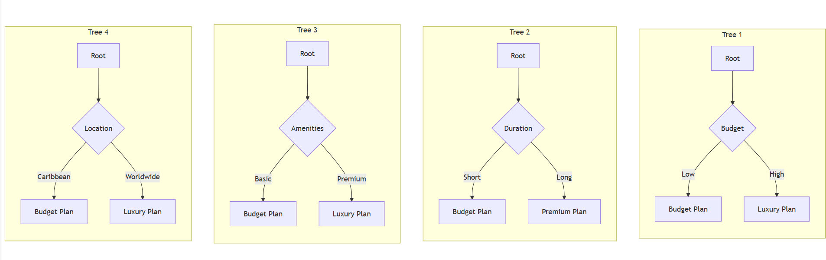
Random Forest – Cruise plan
Notes:
1) Uses 4 trees with different features
2) Each tree specializes in specific criteria
3) Combines predictions for final classification

Slide 35
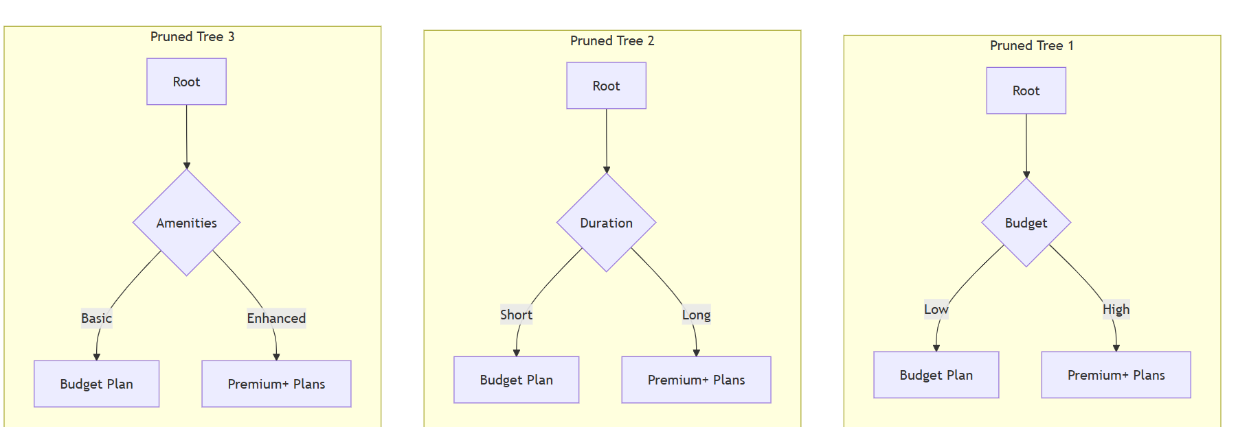
Random Forest Pruned– Cruise plan
Notes:
Reduced to 3 Core trees
Simplified Decision paths
Merged Premium/Luxury into single category.

Slide 36
Random Forest
Definition
Visualization
Performance metrics
It used for both Regression and Classification tasks. Its ensemble method that constructs multiple decision trees to improve accuracy and robustness.
Each decision tree is trained on a random subset of the data, and predictions are made by averaging (for regression) or majority voting (for classification) across the trees.
Regression:
Mean Absolute Error (MAE)
Mean Squared Error (MSE)
Root Mean Squared Error (RMSE)
R-squared (R²)
Adjusted R-squared.
Classification:
Accuracy
Precision
Recall (Sensitivity)
F1-Score

Slide 37
Random Forest– Use cases
Use Case | Description | Model Type
Disease Diagnosis | Predicts the likelihood of a disease (e.g., diabetes, heart disease) based on patient data(Age, Glucose Level, Blood Pressure, Symptoms). | Classification
Customer Segmentation | Classify customers into segments for targeted marketing campaigns. | Classification
Predicting House Prices | Predict house prices based on features like location, size, and amenities. | Regression
Fraud Detection | Identifies fraudulent transactions based on historical transaction patterns(Amount, Location, Time of Day, Merchant Type). | Classification
Stock Price Prediction | Forecast stock prices using historical and technical indicators. | Regression

Slide 38
What is the main difference between a Decision Tree vs Random Forest (Select all that applicable)
A decision tree is faster while training.
A Random Forest is always more accurate.
A Decision Tree is single model, while a Random Forest is an ensemble of multiple trees.
Random forest can only be used for Classification , not Regression

Slide 39
How does a Random Forest typically make its final predictions
By selecting the best performing tree.
By taking the majority vote or average of all the trees in the Random Forest.
By using only, the deepest tree in the forest.
By randomly selecting one tree’s prediction.

Slide 40
Which algorithm allows a Bob to make “if-then” rules , like “If temperature is high and rainfall is low, expect fewer Mangoes”?
Decision Tree
Linear Regression
K-nearest Neighbors
Random Forest.

Slide 41
Bob wants a more accurate prediction by considering multiple weather conditions (e.g., temperature, rainfall, soil type, fertilizers) without overfitting. Which algorithm would help him combine multiple decision paths for balanced predictions?
Decision Tree
Linear Regression
Hierarchical Clustering
Random Forest.

Slide 42
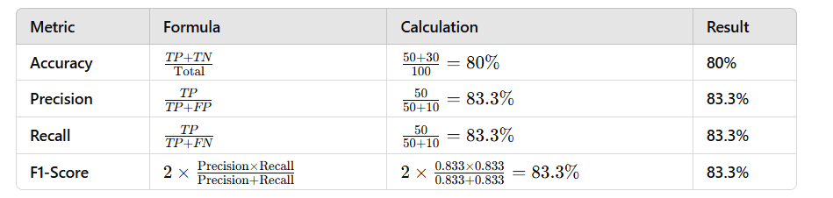
Accuracy, Precision, Recall and F1-Score
Out of 100 emails, the model identifies 60 as spam, but only 50 of them are actually spam. There are 40 non-spam emails, and the model correctly identifies 30 of them.
TP= 50 TN =30 FP=10 and FN=10

Slide 43
K-Means Clustering
Definition
Visualization
Performance metrics
It neither use for Classification nor Regression. It is Clustering (un-supervised learning) technique. It is a way to group similar things together into clusters.
The algorithm does something similar for your data by looking at features like size, weight, or other measurable traits and grouping data points that are similar.
Inertia (Within-Cluster Sum of Squares)
Silhouette Score
Calinski-Harabasz Index
Davies-Bouldin Index

Slide 44
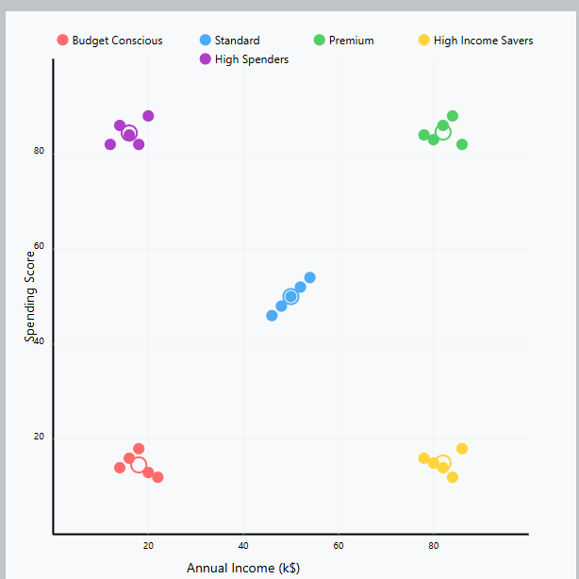
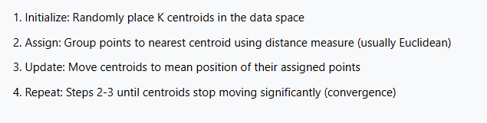
K-Means clustering – Visual and Algorithm learning steps
How to choose correct K Value:
Elbow method
Silhouette Score
Cross-Validation
Domain knowledge
Notes:
Mall Customer Segmentation using K-Means clustering.

Slide 45
K-Means Clustering – Use cases
Use Case | Description
Customer Segmentation | Group customers based on behavior (purchase patterns) or preferences.
Image Compression | Reduce the size of an image by clustering similar pixel colors.
Anomaly Detection | Identify unusual data points in a dataset. (Fraud detection in banking transactions)
Document Clustering | Group similar documents or articles. (Organizing news articles into categories)
City Planning | Segment regions based on geographic or demographic data. (Finding optimal locations for new stores)

Slide 46
Principal Component Analysis (PCA)
Definition
Performance metrics
PCA is Dimensional reduction technique.
PCA is a preprocessing step and not a modeling method itself. PCA works for both regression and classification as a preprocessing step.
It's not a modeling technique itself but rather a dimension reduction tool that can be used before applying any model.
Explained Variance Ratio
Reconstruction Error
Model Metrics
Kaiser criterion (eigenvalues > 1)

Slide 47
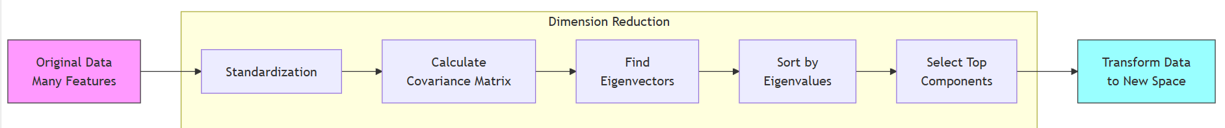
Principal Component Analysis (PCA) – steps
Handling Multiple X Values: PCA automatically handles multiple features by:
First standardizing all variables (making them comparable)
Finding directions (principal components) where data varies the most
Each new component is perpendicular to the previous ones
How PCA Works:
Standardize the Data: If features have different scales, normalize them to ensure equal importance.
Compute the Covariance Matrix: This captures relationships between features.
Find Eigenvalues and Eigenvectors: These define the principal components.
Sort and Select Components: The top-k principal components are chosen based on explained variance.
Transform Data: Project the original data onto these new axes.
Notes:
Mall Customer Segmentation using K-Means clustering.

Slide 48
Principal Component Analysis (PCA)– Use cases
Use Case | Description
Gene Expression Analysis | Simplifies large genomic datasets to identify key factors driving differences in samples.
Image Compression | Reduces image size by storing fewer features while retaining visual quality.
Recommender Systems | Reduces feature space for user-item matrices to improve computational efficiency and accuracy.
Stock Market Analysis | Combines multiple stock indicators to find principal trends affecting stock prices.
Customer Segmentation | Groups customers by reducing many features into key segments based on behavior or preferences.

Slide 49
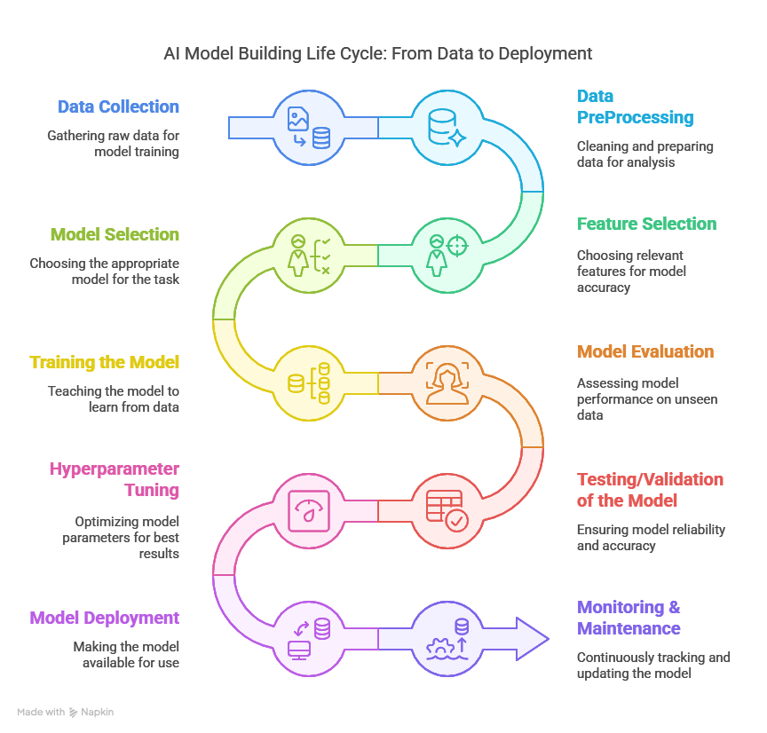

Slide 50
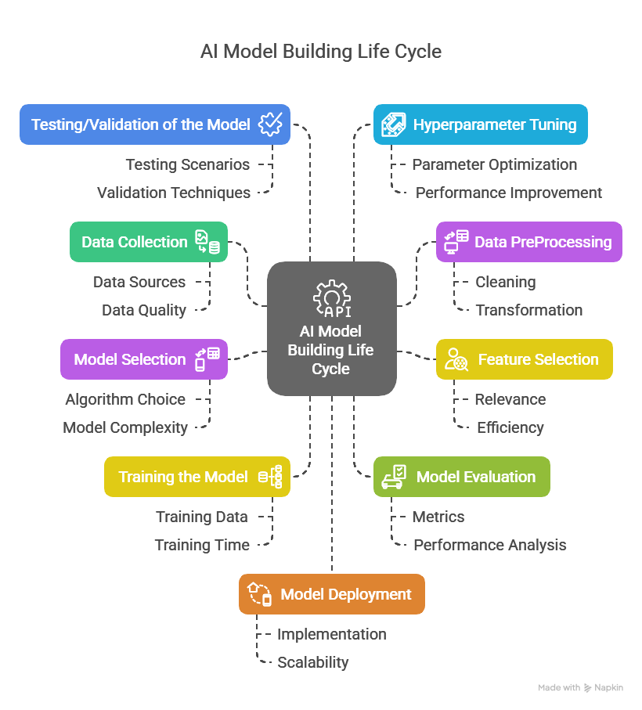

Slide 51
Q& A

